Slide 1

Hand Sign detection USING WEBCAM

Slide 2

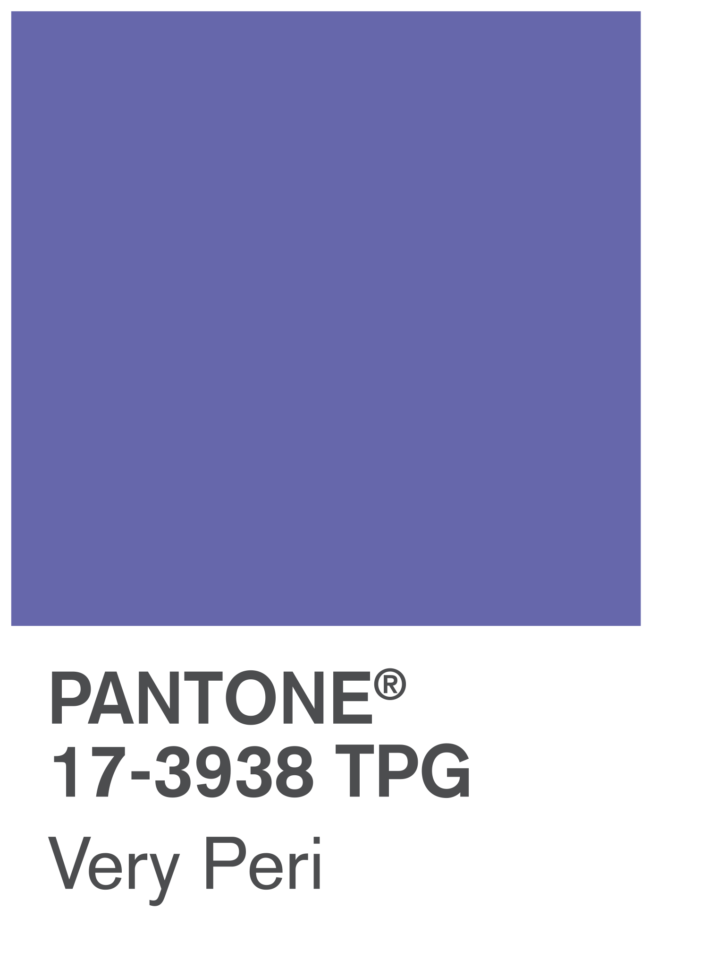
VERY PERI
The Following Are The Contents Of This Presentation
Dealing With:
WHY
The main purpose of choosing this project and idea behind developing this model
Introducing the Pantone Color of the Year 2022. PANTONE 17-3938 Very Peri is a dynamic hue that blends the faithfulness and constancy of blue with the energy and excitement of red.
The four color palettes in this template feature Very Peri to help you express your ideas and convey the right mood. Read on to learn how to use these colors in any presentation.
WHAT
With the notion set in mind, the procedure in order to solve the problem and accomplishing our goal
HOW
Implementation of the project and detecting Hand Signs in Real-Time

Slide 3




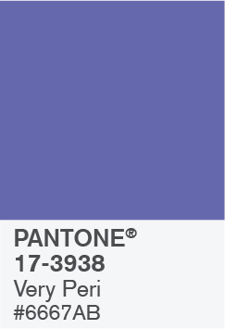



BALANCING ACT
WHY
With the advancement in Technology and Innovation, communication is needed to express one’s ideas and implement them in real life.
But for the people who are differently abled
(Deaf people), they cannot directly hear and talk and convey their message. So, in order to remove this communication gap, this project idea was proposed and built with an aim to help those people who cannot hear and talk.

Slide 4
BALANCING ACT
WHAT
In order to implement the idea, the different requirements such as Python, Tensorflow Object Detection API and LabelImg were installed to detect Hand Signs in Real-Time using Webcam.
The project first opens the Webcam and starts looking for hand signs in the frame. When it detects any hand sign, it recognizes its name and shows accuracy at which it is detecting the hand sign with a bounding box covering the hand sign.
Packages

Slide 5

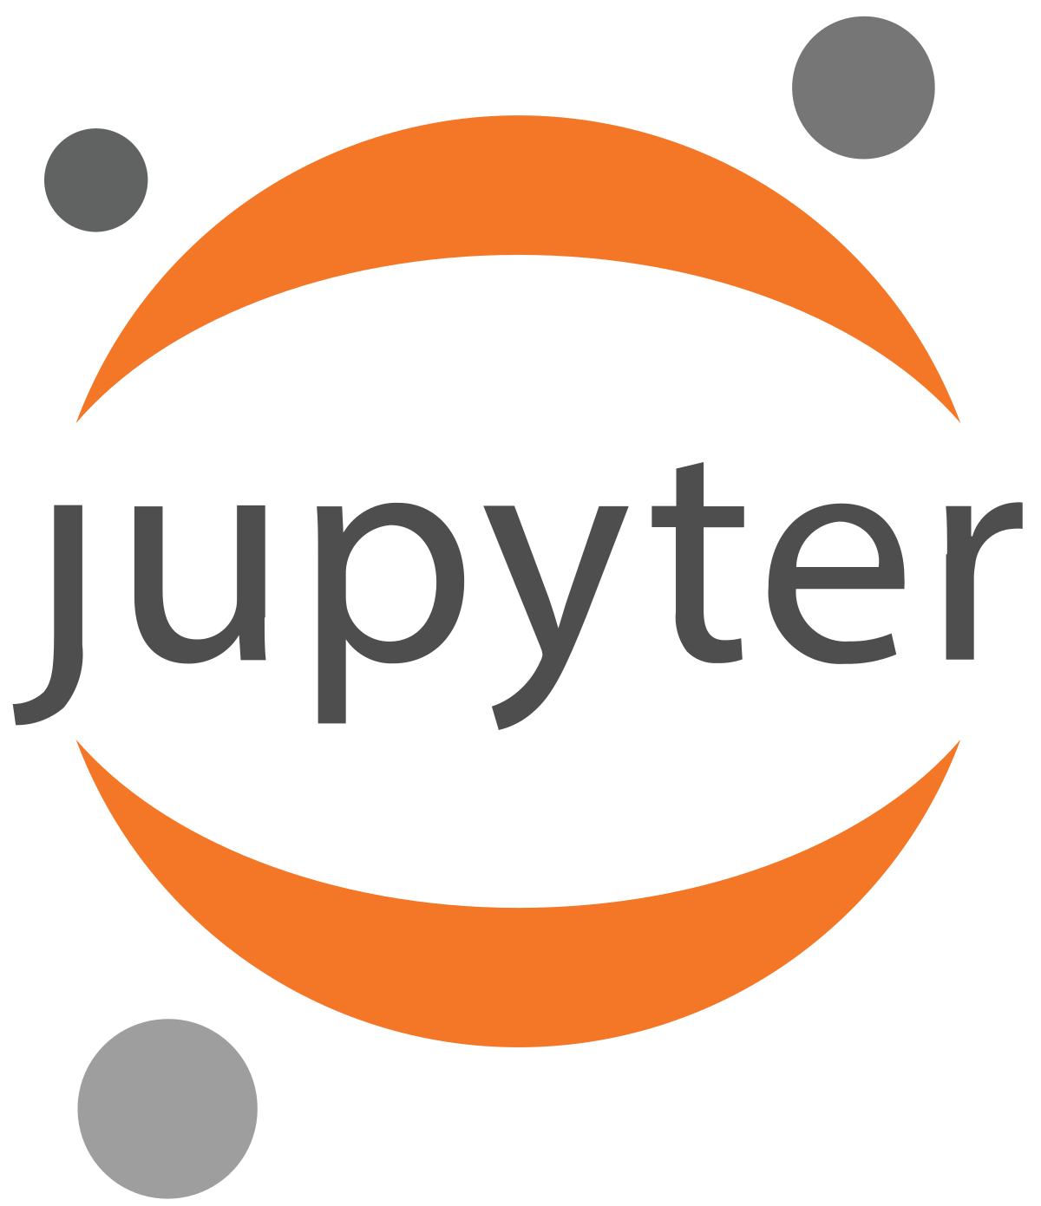
BALANCING ACT
WHAT
SOFTWARES AND PACKAGES USED IN PROJECT
PYTHON – 3.9
Python is a general-purpose high level programming language that is widely used in data science and for producing deep learning algorithms.
Python and its libraries like Numpy, Scipy, Pandas, Matplotlib; frameworks like Theano, TensorFlow, Keras. The tutorial explains how the different libraries and frameworks can be applied to solve complex real world problems.
Jupyter Notebook
The Jupyter Notebook is an open-source web application that allows data scientists to create and share documents that integrate live code, equations, computational output, visualizations, and other multimedia resources, along with explanatory text in a single document.

Slide 6
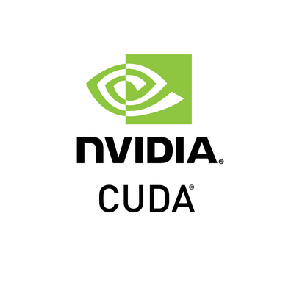
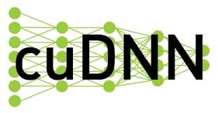
BALANCING ACT
WHAT
SOFTWARES AND PACKAGES USED IN PROJECT
CUDA – 11.2
CUDA® is a parallel computing platform and programming model developed by NVIDIA for general computing on graphical processing units (GPUs). With CUDA, developers are able to dramatically speed up computing applications by harnessing the power of GPUs.
cuDNN – 8.1.0
The NVIDIA CUDA® Deep Neural Network library (cuDNN) is a GPU-accelerated library of primitives for deep neural networks. cuDNN provides highly tuned implementations for standard routines such as forward and backward convolution, pooling, normalization, and activation layers

Slide 7
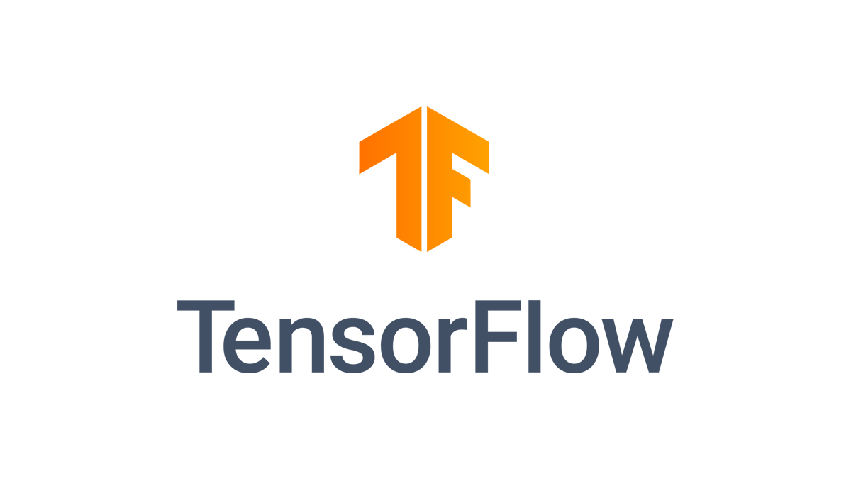

BALANCING ACT
WHAT
SOFTWARES AND PACKAGES USED IN PROJECT
Tensorflow – 2.7.0
TensorFlow is an end-to-end open source platform for machine learning. It has a comprehensive, flexible ecosystem of tools, libraries and community resources that lets researchers push the state-of-the-art in ML and developers easily build and deploy ML powered applications.
VS Community 2019
A fully-featured, extensible, free IDE for creating modern applications for Android, iOS, Windows, as well as web applications and cloud services.
It provides C++build tools for
CUDA and cuDNN.

Slide 8

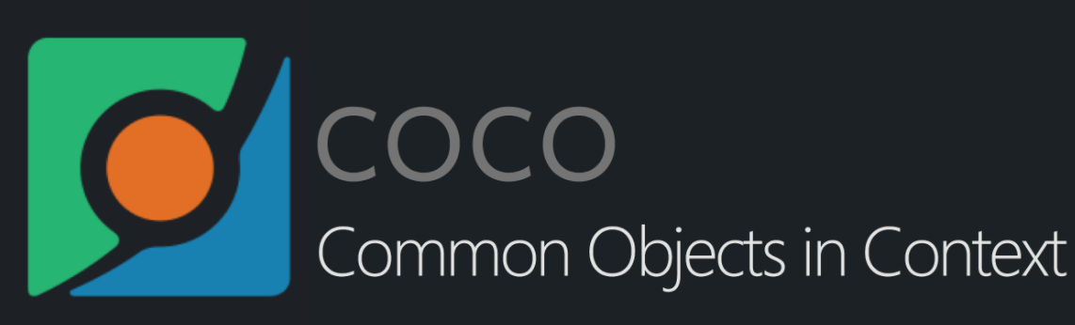
BALANCING ACT
WHAT
SOFTWARES AND PACKAGES USED IN PROJECT
Protobuf – 3.19
Protocol buffers are Google's language-neutral, platform-neutral, extensible mechanism for serializing structured data – think XML, but smaller, faster, and simpler. You define how you want your data to be structured once, then you can use special generated source code to easily write and read your structured data to and from a variety of data streams and using a variety of languages.
COCO API
COCO stands for Common Objects in Context, as the image dataset was created with the goal of advancing image recognition. The COCO dataset contains challenging, high-quality visual datasets for computer vision, mostly state-of-the-art neural networks.

Slide 9
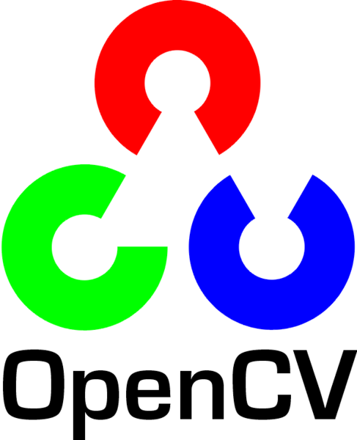
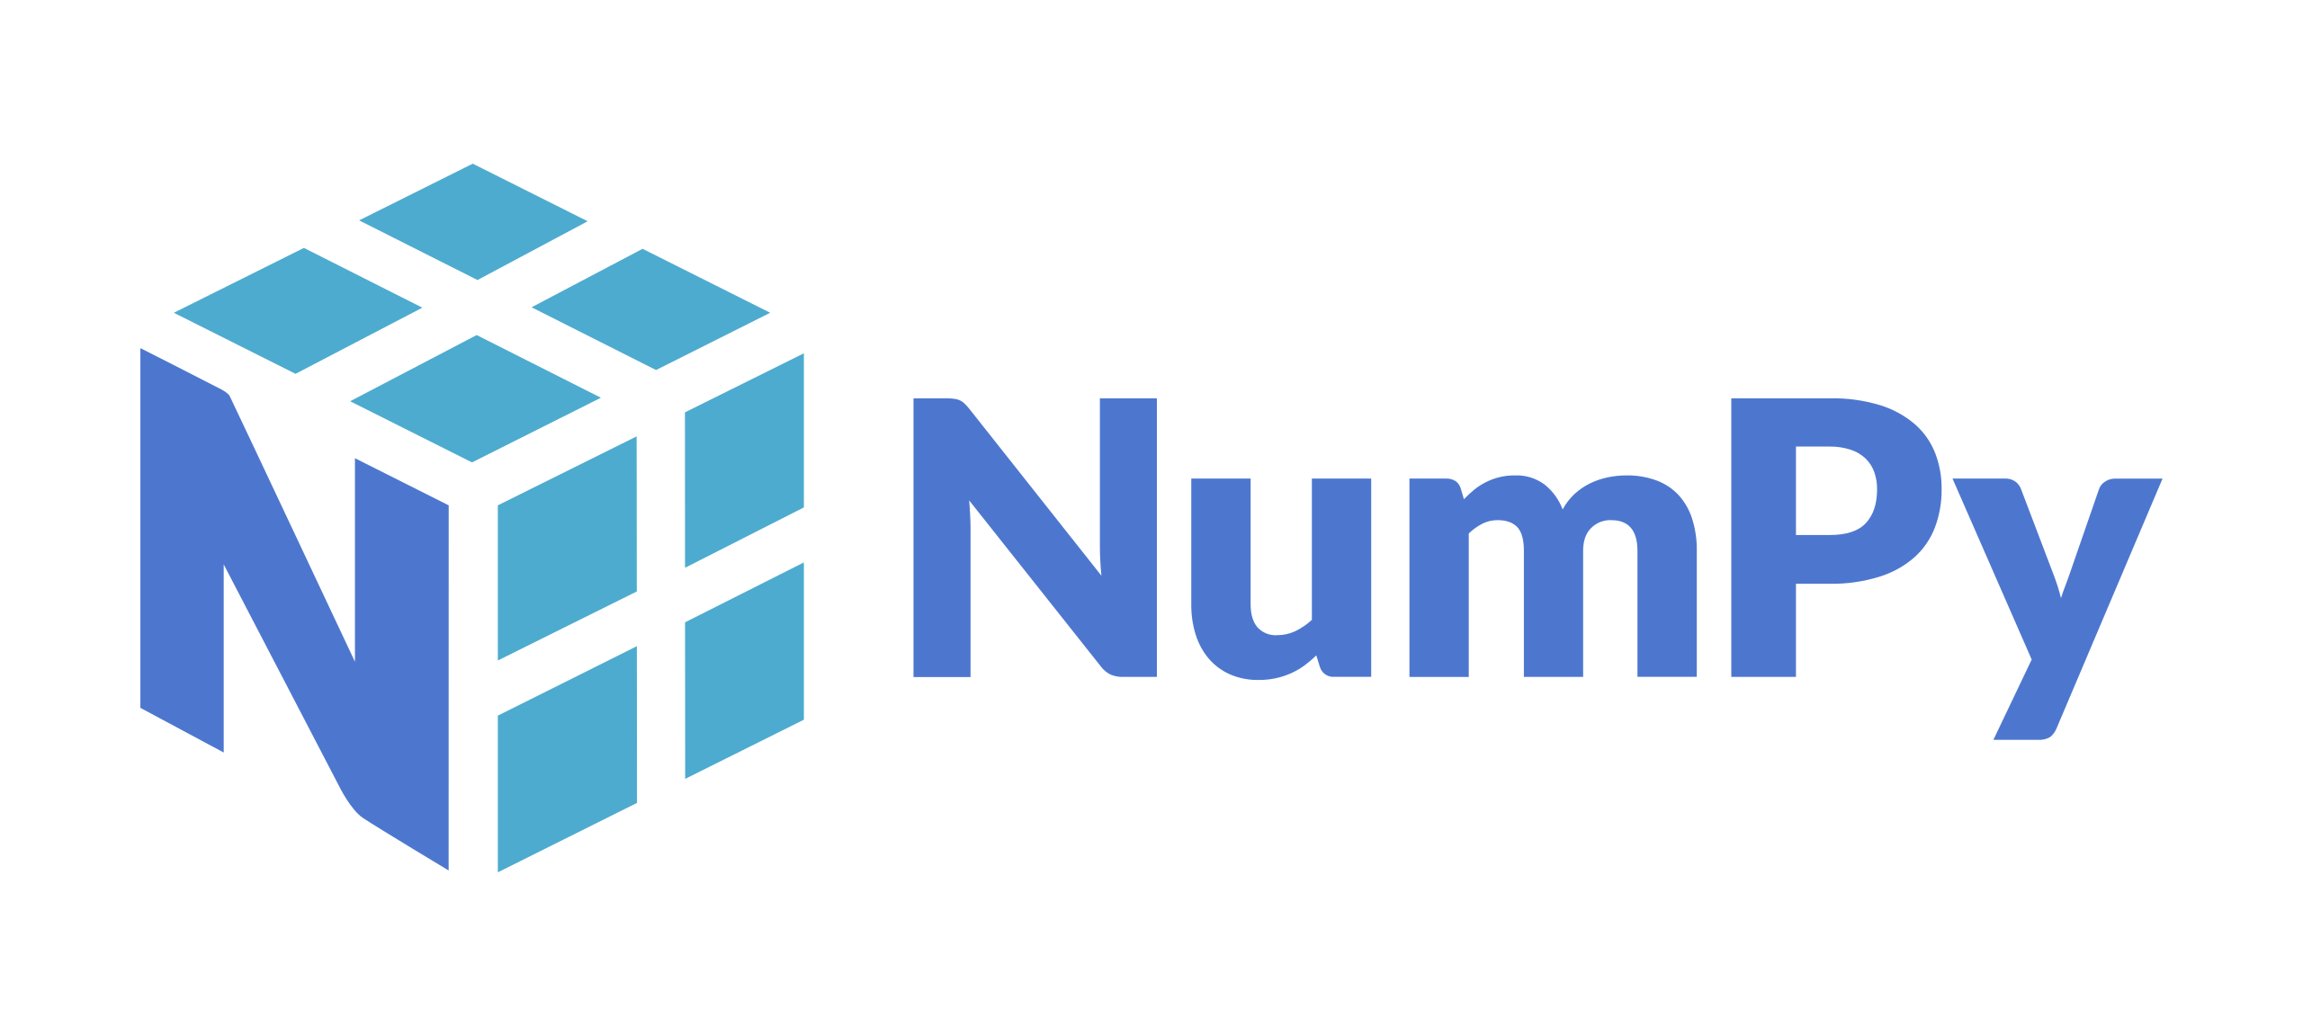
BALANCING ACT
WHAT
SOFTWARES AND PACKAGES USED IN PROJECT
OpenCV
OpenCV (Open Source Computer Vision Library) is an open source computer vision and machine learning software library. OpenCV was built to provide a common infrastructure for computer vision applications and to accelerate the use of machine perception in the commercial products. Being a BSD-licensed product, OpenCV makes it easy for businesses to utilize and modify the code.
Numpy
NumPy is the fundamental package for scientific computing in Python. It is a Python library that provides a multidimensional array object, various derived objects (such as masked arrays and matrices), fast operations on arrays, including mathematical, logical, shape manipulation, sorting, selecting, basic linear algebra, and much more.

Slide 10
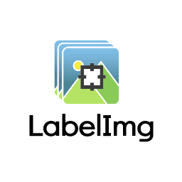
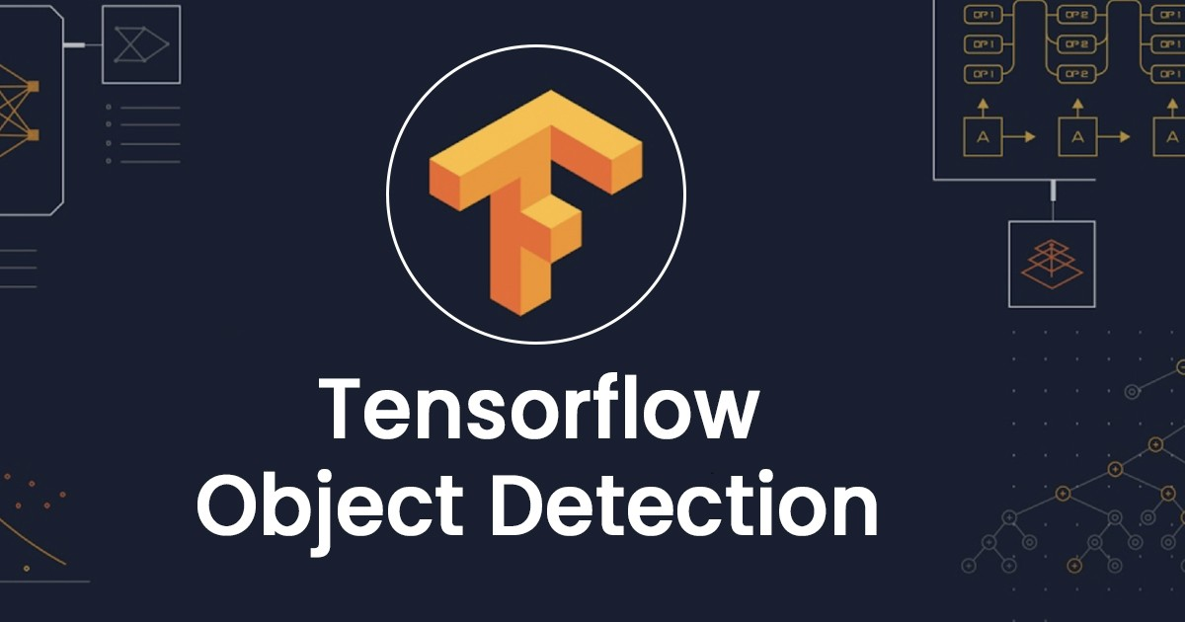
BALANCING ACT
WHAT
SOFTWARES AND PACKAGES USED IN PROJECT
LabelImg
LabelImg is a graphical image annotation tool. It is written in Python and uses Qt for its graphical interface. Annotations are saved as XML files in PASCAL VOC format, the format used by ImageNet. Besides, it also supports YOLO and CreateML formats.
It provides us interface to create bounding boxed around the objects.
Tensorflow Object
Detection API
Creating accurate machine learning models capable of localizing and identifying multiple objects in a single image remains a core challenge in computer vision. The TensorFlow Object Detection API is an open source framework built on top of TensorFlow that makes it easy to construct, train and deploy object detection models.

Slide 11
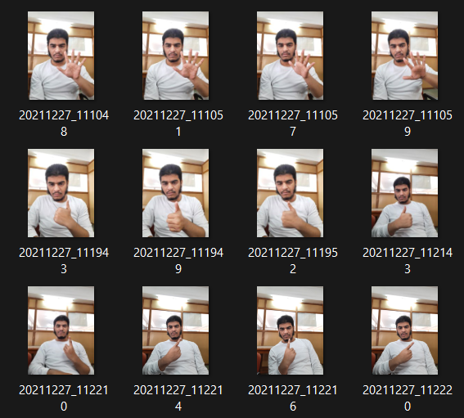
BALANCING ACT
HOW
1. Collecting Images and creating own dataset
This is the first step in which collection of images is done.
Collecting images in different angles and variety of backgrounds gives more accuracy in detecting the hand sign.
It is optimal to keep all the images in same size and dimension so that training can be efficient.

Slide 12

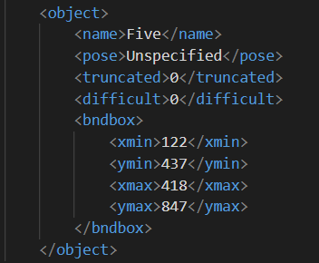
BALANCING ACT
HOW
2. Labelling the images
After collecting all the images, they are classified according to their classes.
Labelling the image means for each class providing a bounding box to the object – here Hand Sign - which needs to be detected.
A Bounding box keeps the location at which object is present in an image.

Slide 13
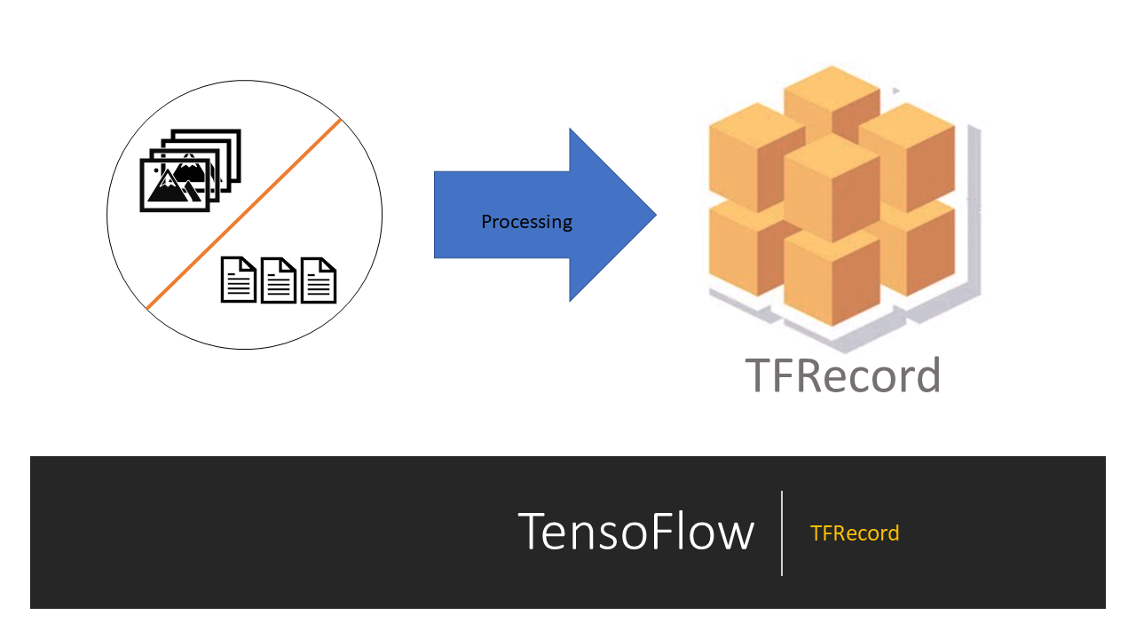
BALANCING ACT
HOW
3. Creating TFRecords
The TFRecord format is a simple format for storing a sequence of binary records. Converting your data into TFRecord has many advantages, such as:
More efficient storage: the TFRecord data can take up less space than the original data.
Fast I/O: the TFRecord format can be read with parallel I/O operations, which is useful for TPUs or multiple hosts.
Self-contained files: the TFRecord data can be read from a single source—for example, the COCO2017 dataset originally stores data in two folders ("images" and "annotations").

Slide 14
BALANCING ACT
HOW
4. Using Transfer Learning to
train our custom dataset
Transfer Learning:
The reuse of a previously learned model on a new problem is known as transfer learning. It’s particularly popular in deep learning right now since it can train deep neural networks with a small amount of data. This is particularly valuable in the field of data science, as most real-world situations do not require millions of labelled data points to train complicated models.
The knowledge of an already trained machine learning model is transferred to a different but closely linked problem throughout transfer learning.
Transfer learning offers a number of advantages, the most important of which are reduced training time, improved neural network performance (in most circumstances), and the absence of a large amount of data.
To train a neural model from scratch, a lot of data is typically needed, but access to that data isn’t always possible – this is when transfer learning comes in handy.

Slide 15
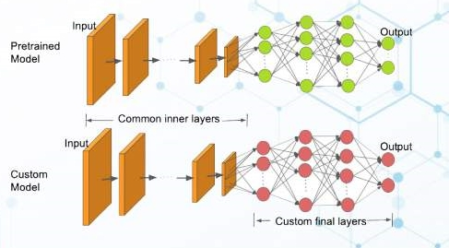
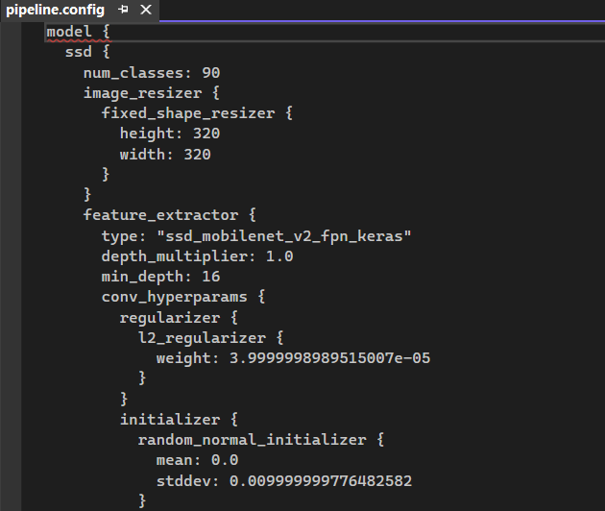
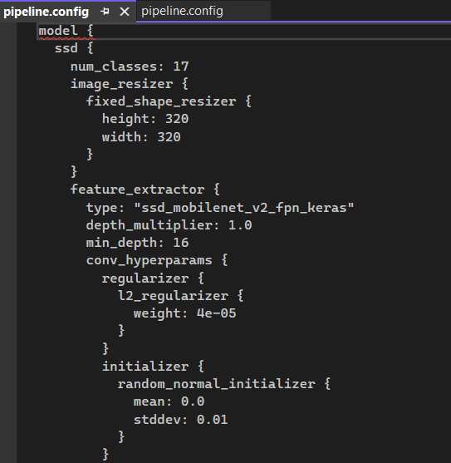

Slide 16
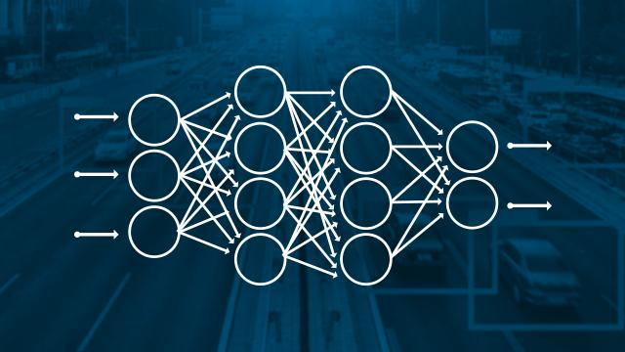
BALANCING ACT
HOW
5. Training the model
After setting up the TFRecords and transfer learning process, the model is ready to be trained. Here, since the dataset is small – each class contains 15 images – more number of epochs are required to get accurate results.
Deep learning models require GPU in order to be trained faster. It can also train on CPU but it not recommended.
For this project, 10000 epochs were required to get better accuracy in Real-Time detection.

Slide 17
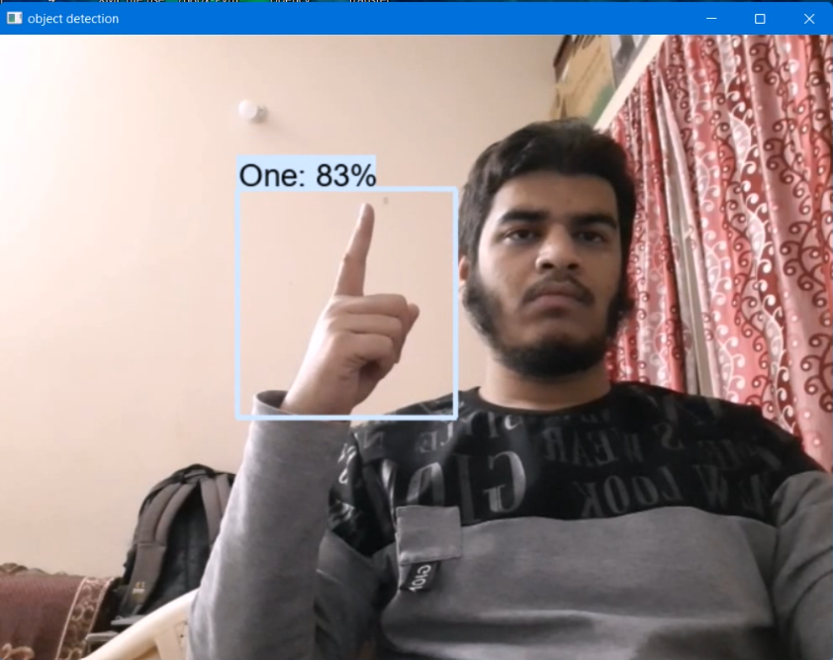
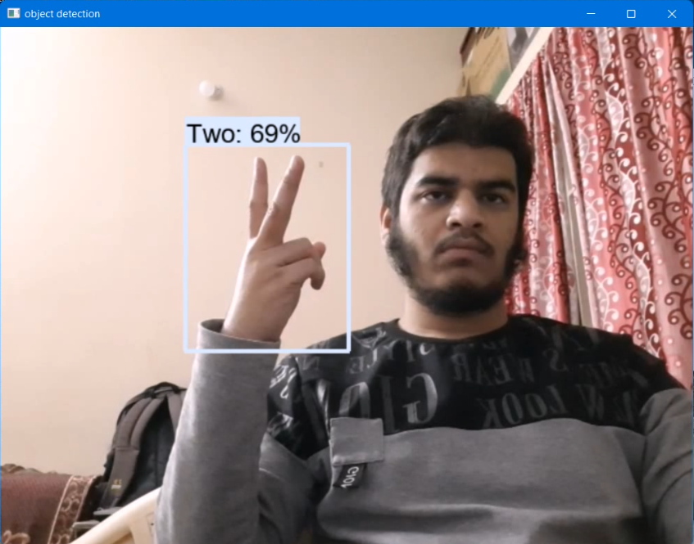
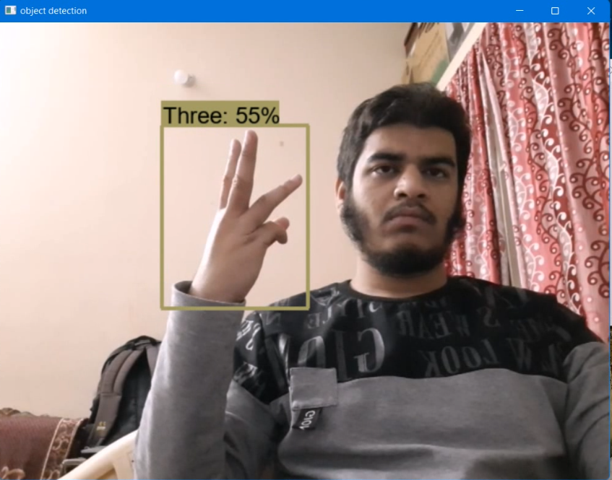
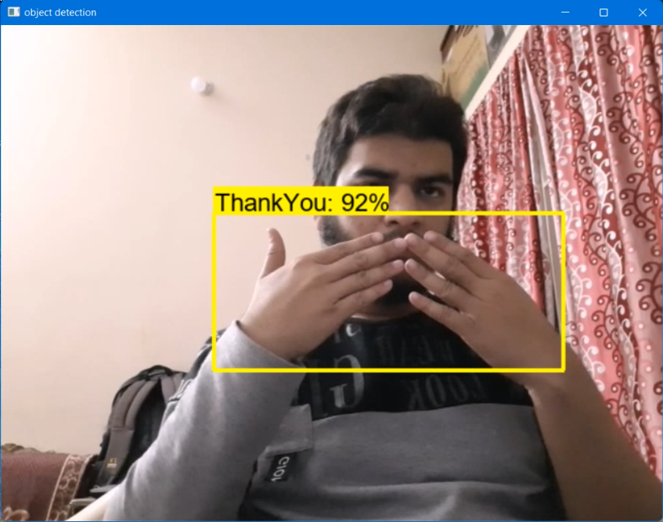
BALANCING ACT
HOW
6. Detecting in Real-Time
After the model is successfully trained, with the help of Opencv and Numpy, the frames of videos are computed and detection of Hand Sign is shown on the screen.
A bounding box is displayed with the name of Hand Sign and the accuracy at which it is detecting the Hand Sign is shown.

Slide 18
BALANCING ACT
CONCLUSION
This project aims to reduce communication gap between people.
By increasing the dataset, the accuracy of detecting Hand Sign can be improved and it can detect in variety of conditions.
It provides an interface for differently abled (deaf people) to be able to communicate through their hand gestures easily and efficiently.

Slide 19
THANK YOU

